Slide 1

Welcome to the 2025 HSMUN Country Draft!
What are the next steps after today?

Slide 2
Prepare to be a delegate at a Civitas MUN
Remember, our program is…

Slide 3
Share your school’s country list with other students in your group ASAP after today.
Remind everyone that EACH student must sign up for the actual session.
All sessions are on separate dates, 9:00 am until 1:00 pm. All are at Webster University in Browning Auditorium: Session A is Nov. 22; Session B is Dec. 6 & Session C is Dec. 13.
The sign up form for Model UN will be posted on the Civitas website early next week and will be in the newsletter. Students should not sign up until they know their country.
Begin reading and learning about your country. There are helpful Resources on the Civitas website.

Slide 4
RESOLUTIONS
Please, no more than 2 resolutions per school submitted.
Submit them in an email to Stephanie by noon the Wednesday before your Saturday session.
Formatting does not need to be perfect.
Consider collaborating on resolutions.
Resolutions do not need to be about the country you are representing.
Passing a resolution is not a win/lose situation.

Slide 5
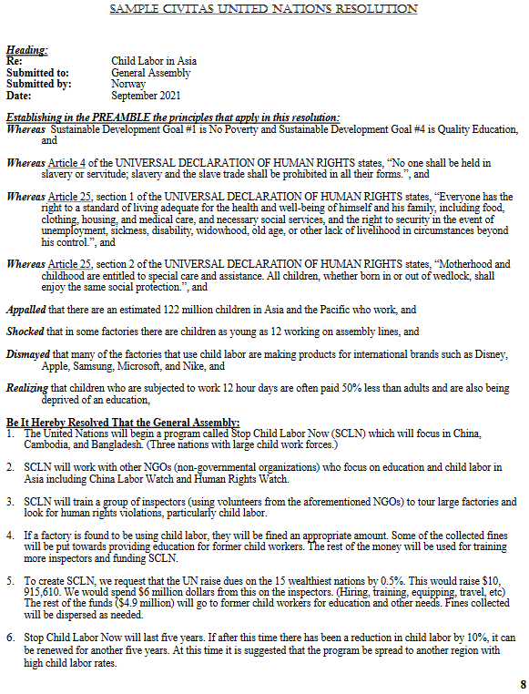
Choose at least 1-3 SDGs and 1-3 Articles from the UDHR list that address the problem.
List a few eye-catching facts from the research you do on the problem. Begin each with a preambulatory phrase listed on resolution template.
Problem-solve! This is where the actual Action of your idea goes, followed by Funding/Budget, Timeline, and Evaluation/Expansion.

Slide 6
Exploring the Civitas website.

Slide 7

Resolution Topic Ideas
What will it take to achieve the Sustainable Development Goals?

Slide 8
AY Young, a UN Young Leader Ambassador, in St. Louis for the UNA-USA Leadership
Summit. He is performing at the UNA-USA Leadership Summit Sat., Nov. 15 @ 5:00 pm
at the Hyatt Regency downtown, followed by Q&A. The concert is free for St. Louis students!
We will have a sign up soon.

Slide 9

https://youtu.be/F9tiqIJSHXE?si=8kc3bU_ok-kgYHra

